Slide 1

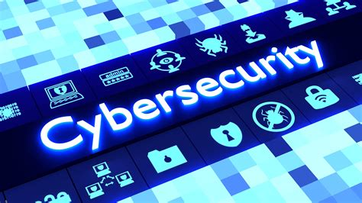
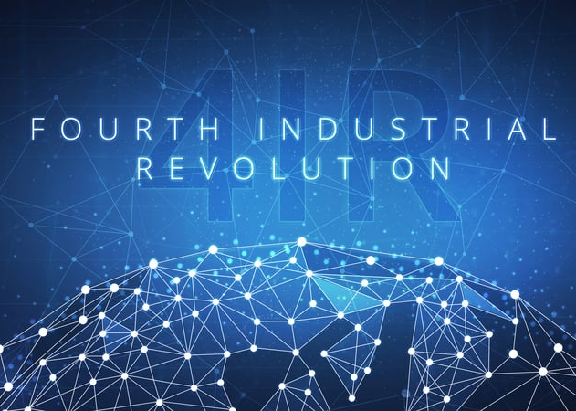
This Photo by Unknown Author is licensed under CC BY-SA
This Photo by Unknown Author is licensed under CC BY

Slide 2
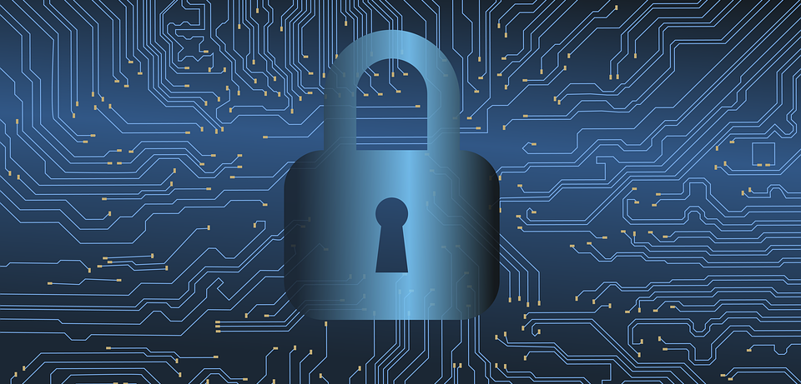
Cybersecurity Challenges in the Fourth Industrial Revolution
Presented by: Lethabo Matsi

Slide 3
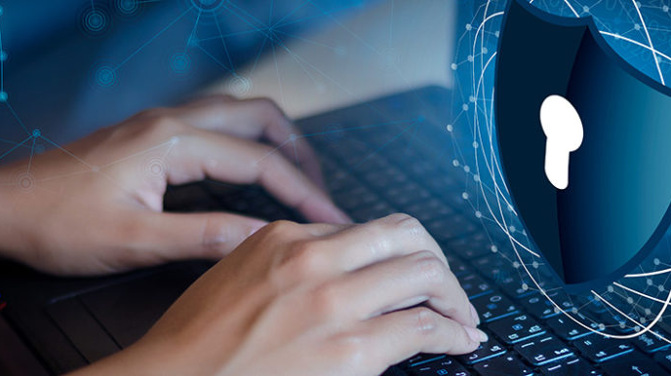
This Photo by Unknown Author is licensed under CC BY

Slide 4
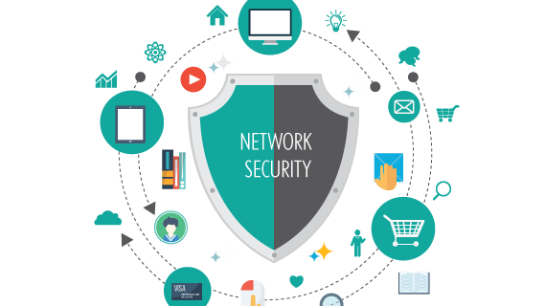
What is cybersecurity?
Cybersecurity involves protecting computer systems, networks, and data from unauthorized access, attacks, or damage.
This Photo by Unknown Author is licensed under CC BY-NC

Slide 5
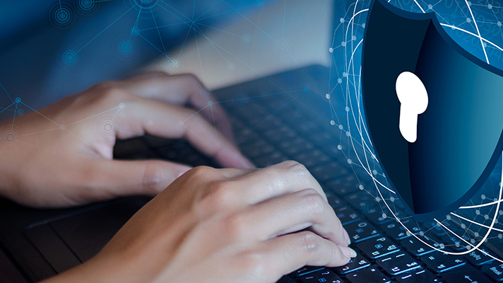
Cybersecurity goals
Confidentiality
Integrity
Authentication
Encryption
This Photo by Unknown Author is licensed under CC BY

Slide 6
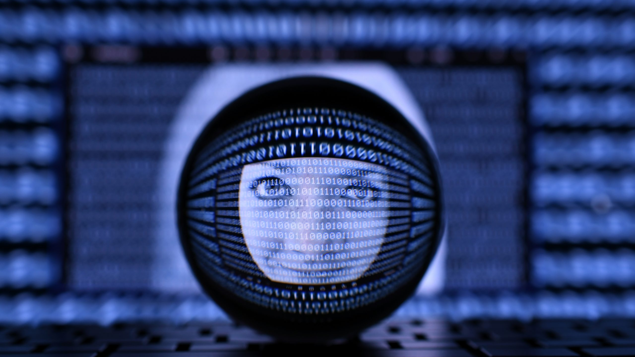
WHat is fourth industrial revolution?
The Fourth Industrial Revolution is a period where advanced technologies like AI, robotics, and smart devices are changing how we live, work, and communicate. It's all about combining the digital, physical, and biological worlds to make things faster, smarter, and more connected.

Slide 7
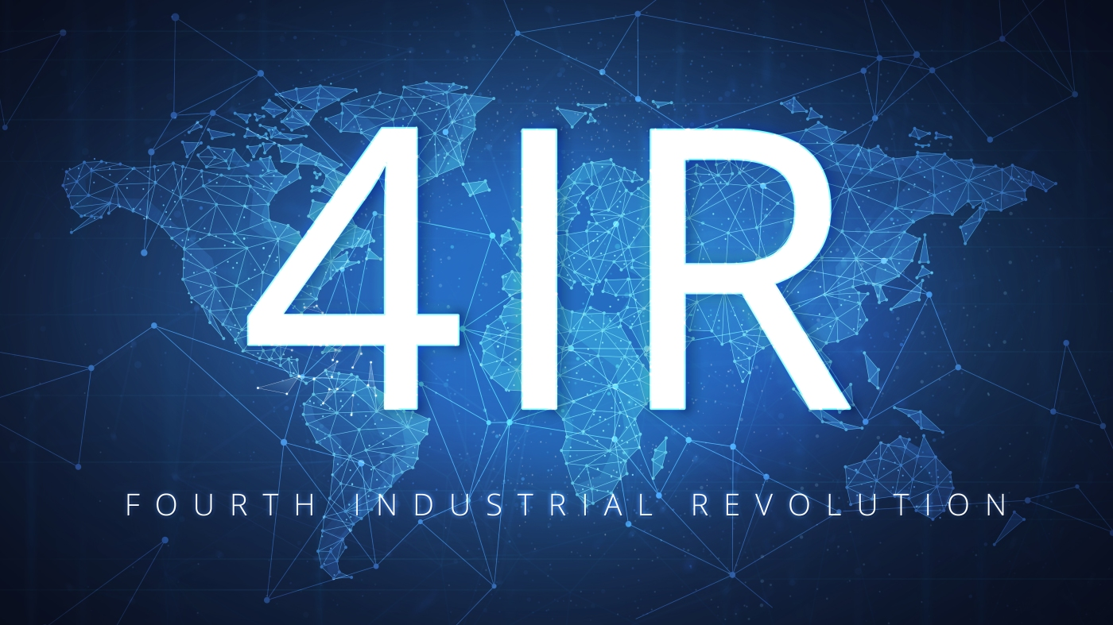
The Dawn of the Fourth Industrial Revolution
The Fourth Industrial Revolution (4IR) began around the early 2010s, driven by rapid advancements in technologies like artificial intelligence (AI), the Internet of Things (IoT), robotics, blockchain, and big data. It was first introduced as a concept by Klaus Schwab, the founder and executive chairman of the World Economic Forum, in 2015, and gained prominence with his book The Fourth Industrial Revolution published in 2016.
This Photo by Unknown Author is licensed under CC BY-NC-ND

Slide 8
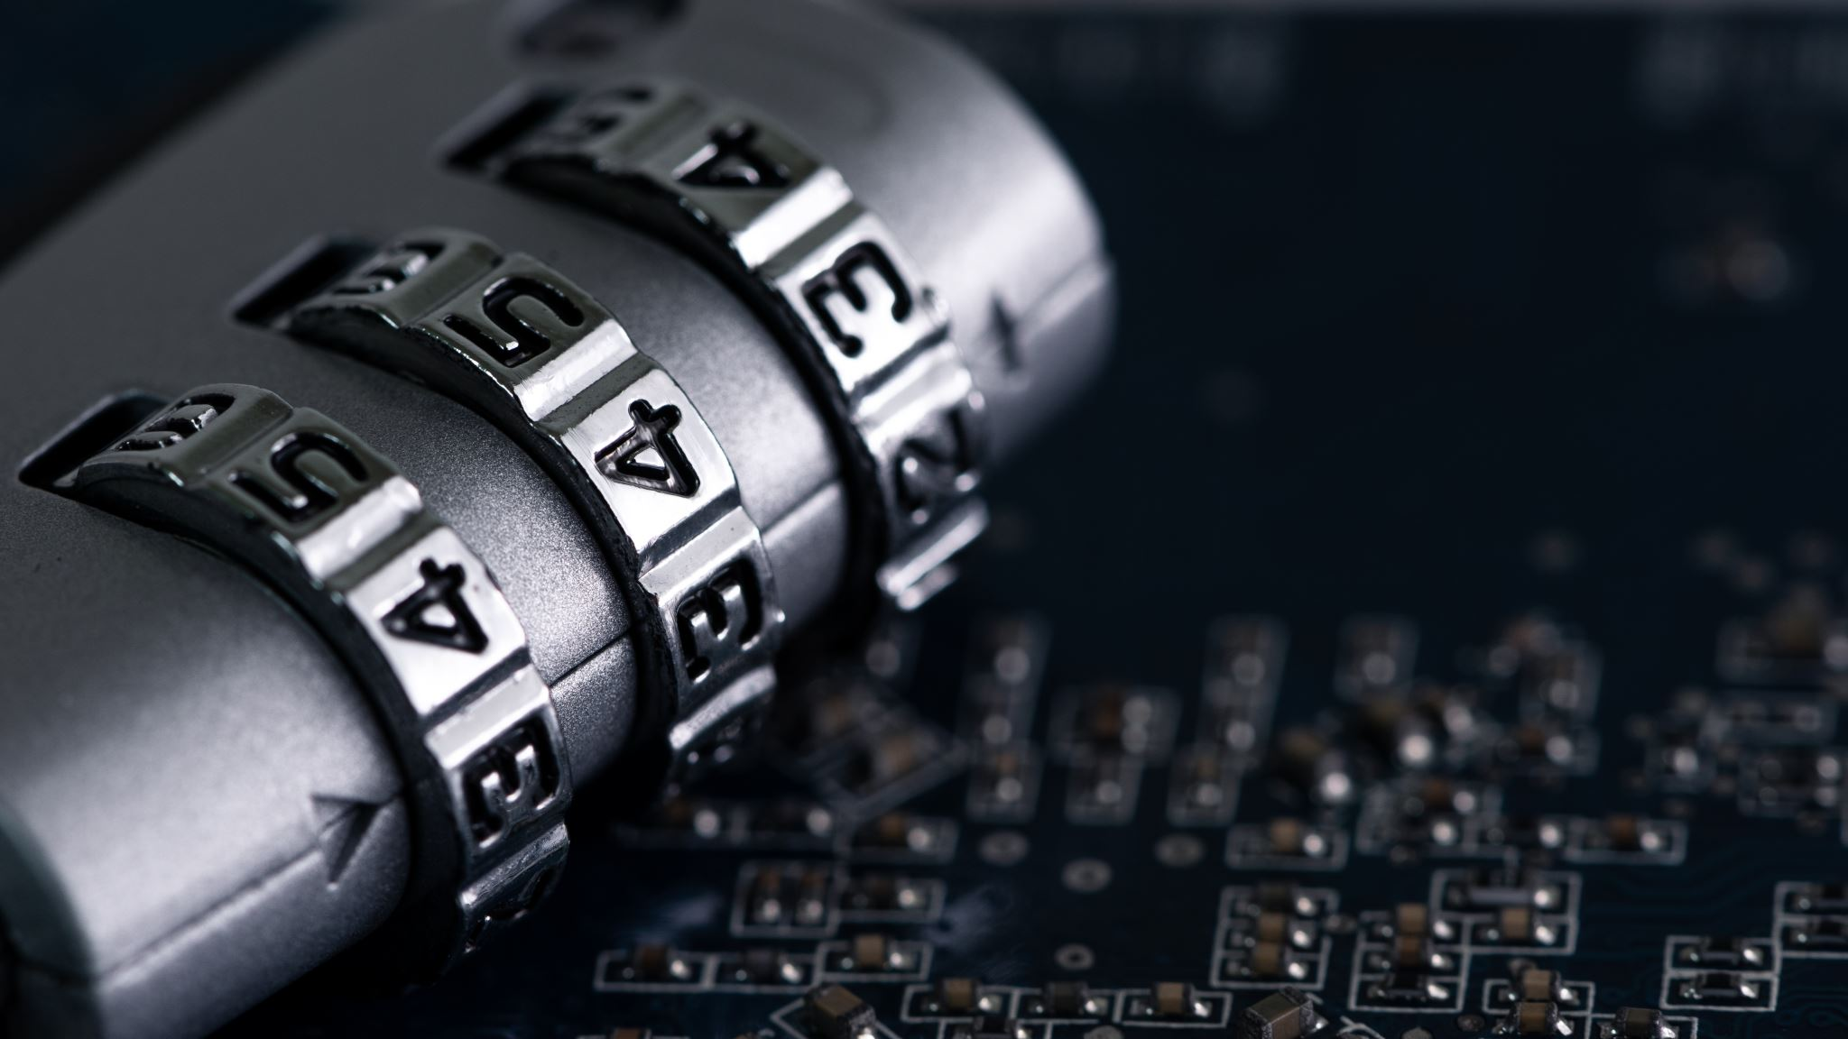
CHALLENGES FOR CYBERSECURITY IN FOURTH INDUSTRIAL REVOLUTION

Slide 9
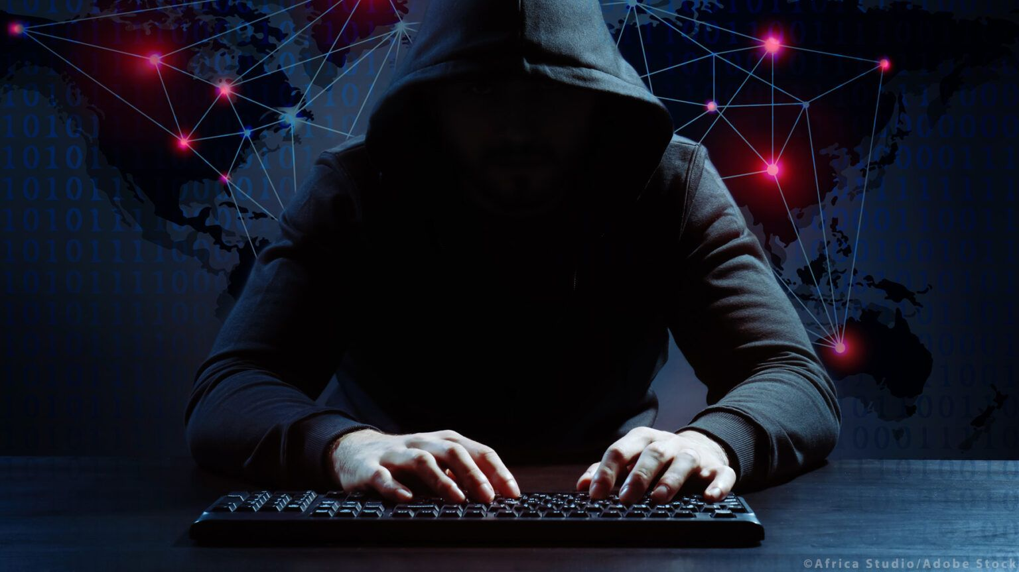
Increased attack surface
This Photo by Unknown Author is licensed under CC BY-NC

Slide 10
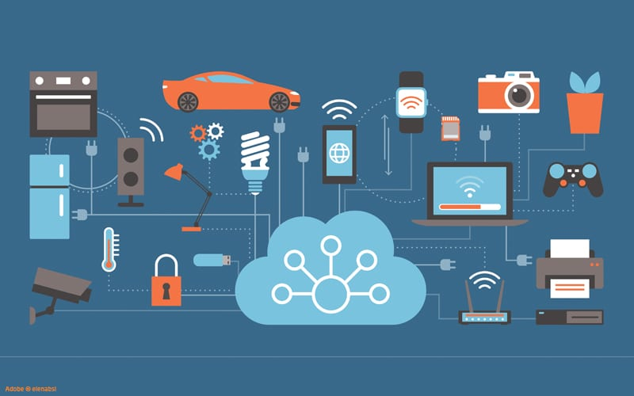
Complexity of technologies
This Photo by Unknown Author is licensed under CC BY-NC-ND

Slide 11
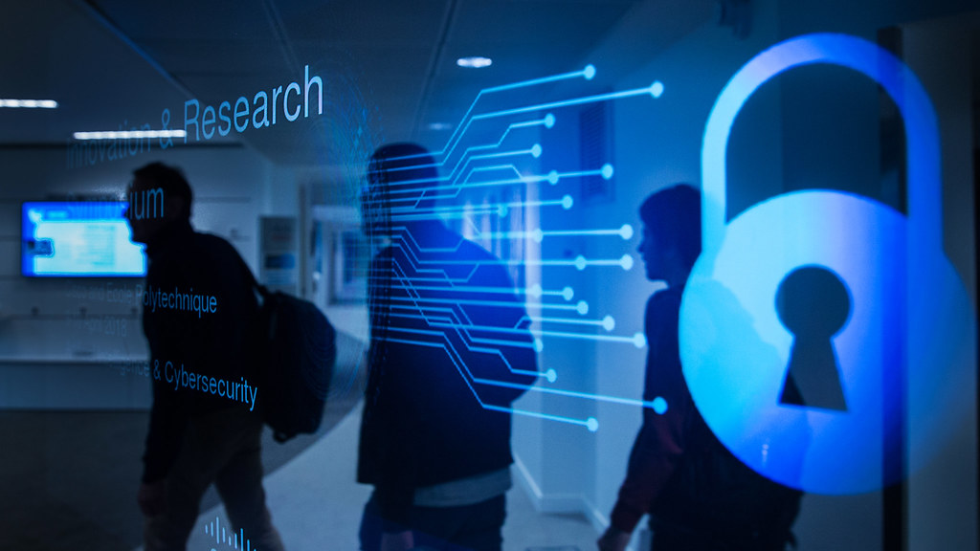
Data privacy and security
This Photo by Unknown Author is licensed under CC BY-SA

Slide 12
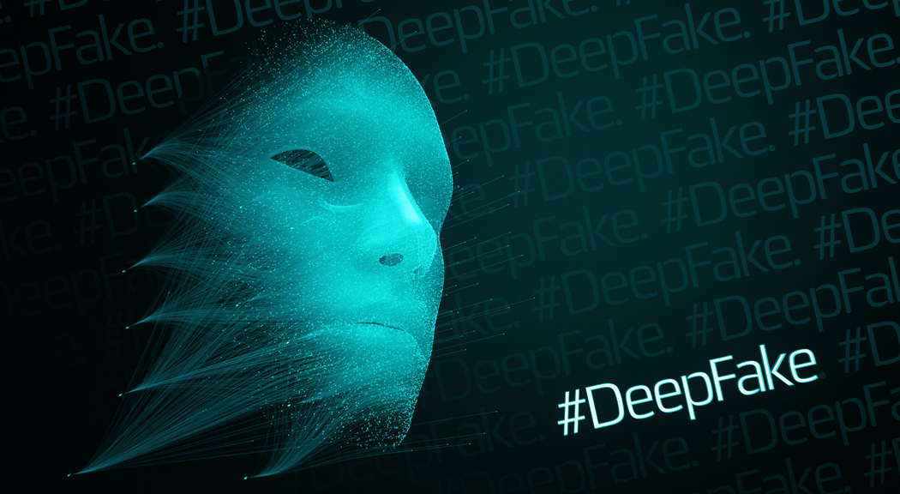
Evolving threats
This Photo by Unknown Author is licensed under CC BY-NC-ND

Slide 13

Skill shortage
This Photo by Unknown Author is licensed under CC BY-ND

Slide 14
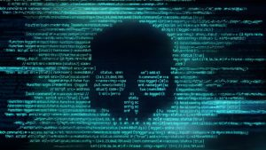
Real Life Cyber-attacks in South Africa
This Photo by Unknown Author is licensed under CC BY-SA

Slide 15
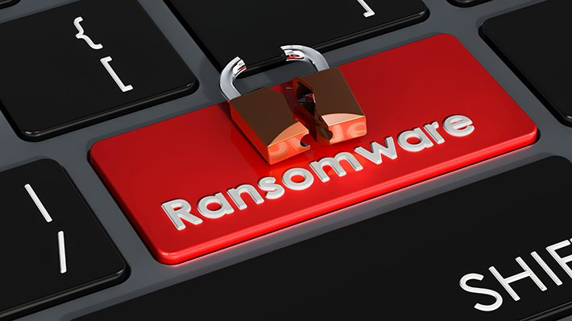
Transnet Cyberattack (2021)
Transnet, South Africa’s state-owned logistics company, suffered a significant ransomware attack in July 2021. This attack disrupted operations at South Africa’s major ports, leading to delays in cargo handling and transportation. The company had to declare a force major on some operations due to the severity of the attack.
This Photo by Unknown Author is licensed under CC BY-ND

Slide 16
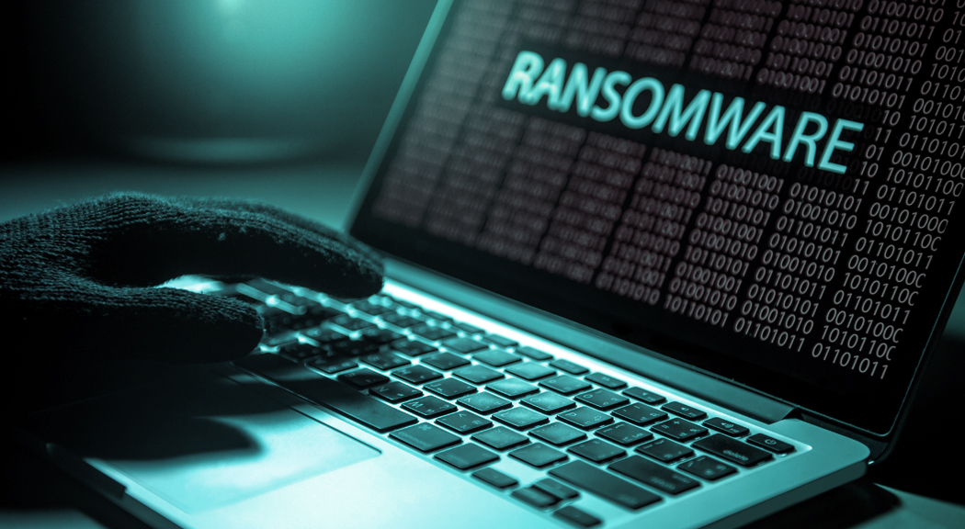
Department of Justice and Constitutional Development Ransomware Attack (2021)
In September 2021, South Africa's Department of Justice and Constitutional Development was hit by a ransomware attack that disrupted its IT systems, including email and online services for court cases. This forced courts to operate manually and delayed legal proceedings across the country. The attack affected the department's ability to process child maintenance payments and other essential services.
This Photo by Unknown Author is licensed under CC BY-NC-ND

Slide 17
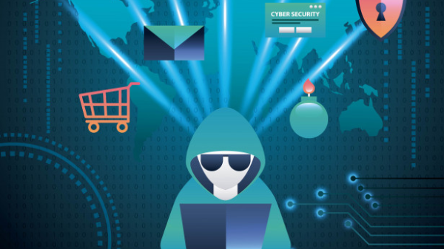
Liberty Life Cyberattack (2018)
Liberty Life, one of South Africa's largest insurers, suffered a significant cyber breach in 2018 when hackers gained access to their systems and demanded a ransom for the return of sensitive customer data. The company initially downplayed the incident but later admitted the breach, stating that no financial loss or customer data had been compromised. However, the attack raised concerns about the security of personal information in the financial sector.
This Photo by Unknown Author is licensed under CC BY-NC-ND

Slide 18
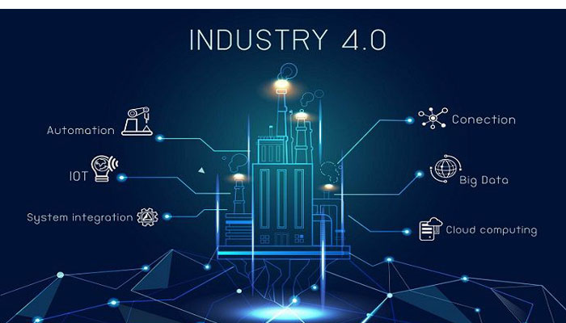
CONCLUSION
The Fourth Industrial Revolution has introduced advanced technologies that are transforming how we live and work, but with this innovation comes increased cybersecurity challenges. The expanded attack surface, technological complexity, evolving threats, and a shortage of cybersecurity skills are critical obstacles. Addressing these challenges requires collaborative efforts, emerging solutions, and upskilling the workforce to protect systems and data. As we continue to embrace the benefits of the 4IR, ensuring robust cybersecurity measures is essential for securing our digital future​.
This Photo by Unknown Author is licensed under CC BY

Slide 19
References
Journal of Cyber Policy
News24
World Economic Forum
IEEE Explore
Cisco Security Blog
IBM Security Intelligence
Capgemini Research
This Photo by Unknown Author is licensed under CC BY
This Photo by Unknown Author is licensed under CC BY

Slide 20

THANK YOU

